Slide 1


Pragati Student Record Keeping
Presented By : SUBHADEEP DATTA | GURTEJ SINGH REHAL
Team : Smart . Innovate

Slide 2






Our understanding of the challenge
A student undergoes many institutions to attain the desire education.
Each time, the student has to present his ID and past education details at the new institute for verification purpose.
As the number of documents and certificates increases, it increases difficulty in the process for the verifying authorities.
Also if a student misplaces his documents while carrying, it takes him months before he gets a new one.

Slide 3

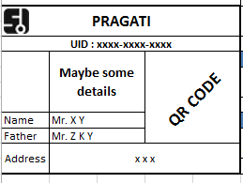



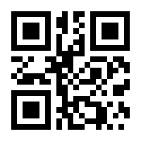






Proposed Solution
The smart card – providing a common platform for Academic records.
Academic records of student
User-friendly Dashboard
Documents verified using robust algorithms
Access to registered Institutions or Organizations
Storage of Documents & Certificates
Customized Resume
Sharing of records secured
Issue of new certificate on loss becomes easy

Slide 4






Objective
Provide a common platform for keeping track of academic qualification of an Individual
One stop solution for Academic records
Reduce headache of carrying documents for students
Prevent piracy of documents
Reducing workload of verification officials
Customized dashboard and Resume for students

Slide 5




Expected Outcomes
Eliminating carrying of files during interviews or admissions
Preventing the risk of losing/misplacing the original documents
Simplifying and organize the students dashboard so that it becomes easy for the admission council/interview panel to evaluate
Guaranteeing the authenticity of the certificates by doing a two-step verification
Can be used for verification purpose for various competitive examinations

Slide 6

How does it work ?
Our Working philosophy can be broken down in two parts
Generation of the Smart Card
Access to the student database
by Institution/Organization

Slide 7



How does it work ?
Generation of the Smart Card
Access Rights:
Marks obtained directly from the boards’ database
Students cannot modify or update the marks on their dashboard
Students can only Upload/Modify/Delete documents
Uploaded or edited documents gets verified by our algorithm
Database of
students
Pragati UID

Slide 8
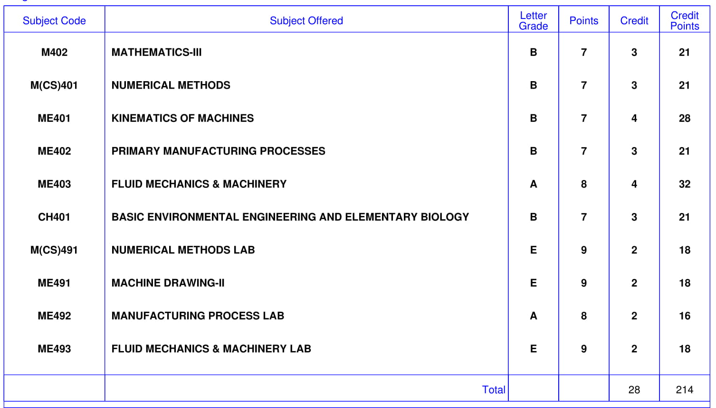
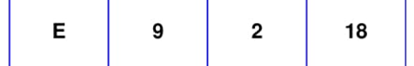
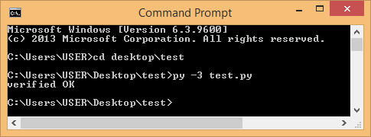

How does it work ?
216

Slide 9
How does it work ?
Access to the student database
by Institution/Organization
Student’s Records
The institutes willing to fetch data from Pragati, should be registered to our organization. This ensures that the student’s database is not accessed by any unwanted individuals.
To view student’s details, the organization needs to log into our portal and scan the QR.
However, the organization cannot make any changes to the data.

Slide 10









Technology Stack
HTML
CSS
JavaScript
BootStrap
jQuery
chartJs
MySQL
PHP
Python
Java
UI/UX
DATABASE
BACKEND

Slide 11

What is the USP?
One stop solution for Digital Academic Records
Documents verified using robust Algorithm, reducing verification time
Dashboard and Resume builder to assist student organize their records

Slide 12

Solution Architecture
Encrypted Data
Student’s Records
Database of
students
Decrypted Data
Log In portal
Pragati UID

Slide 13


Risk, Issues and Mitigation plan
Since we are using QR for our solution, there is a probability of the student’s data getting into wrong hands.
The QR will contain encrypted information.
The concerned Organization/Institute will have to register themselves to get access of Pragati.
Log In portal
Student’s Records
Encrypted Data
Decrypted Data

Slide 14
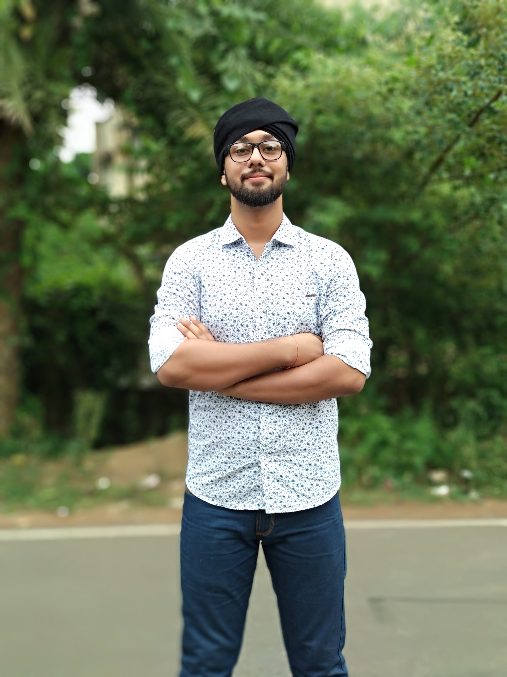
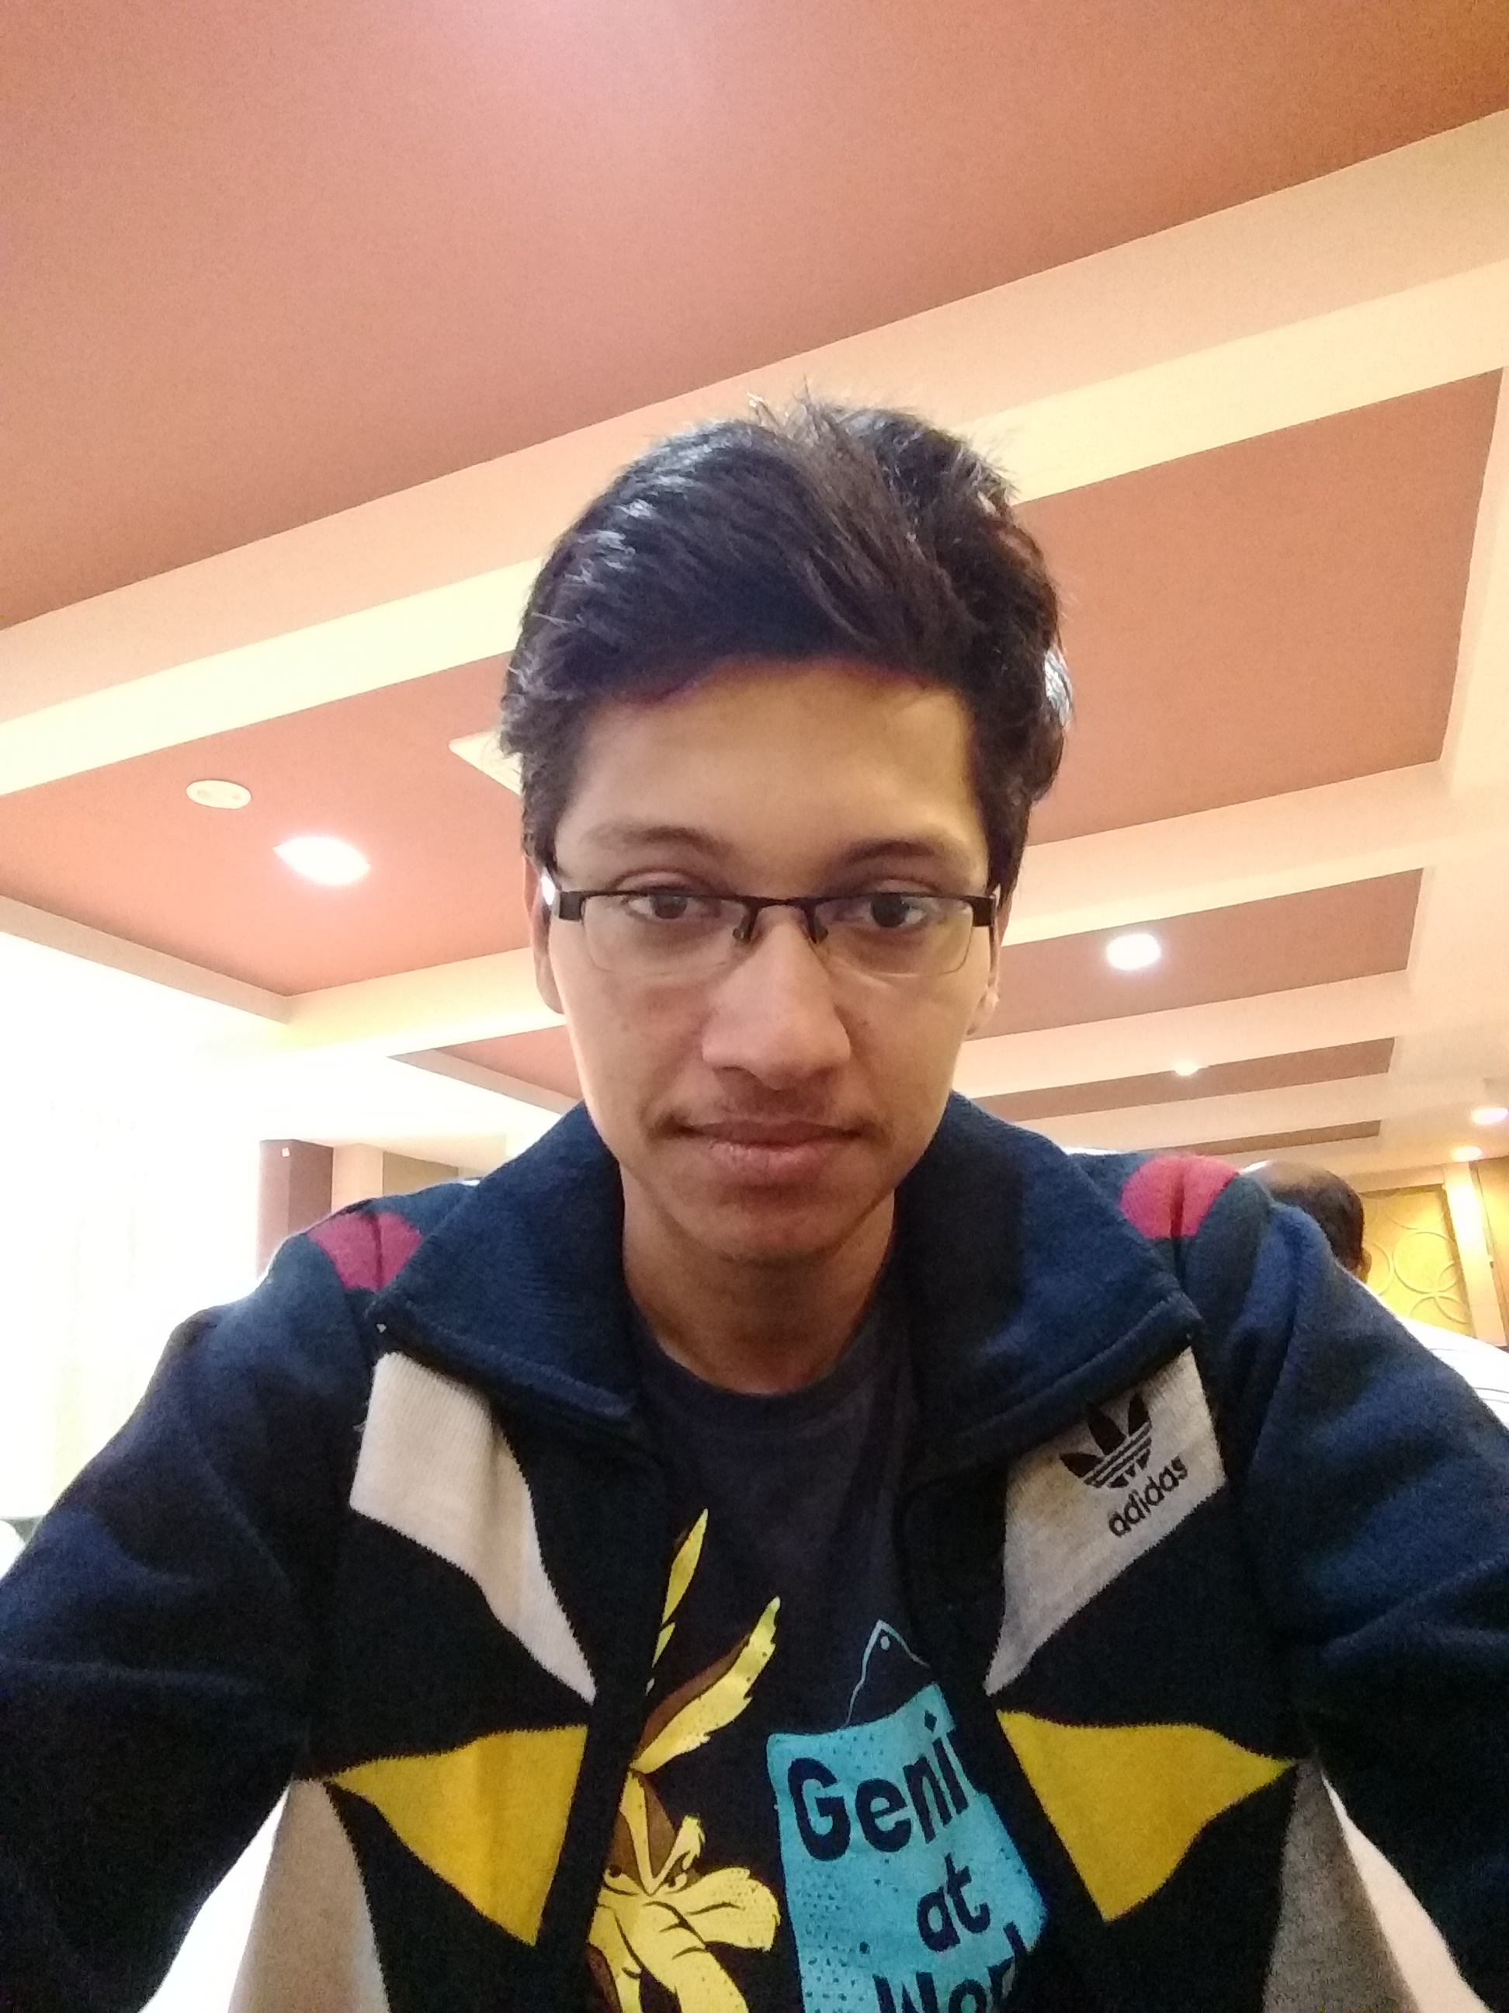
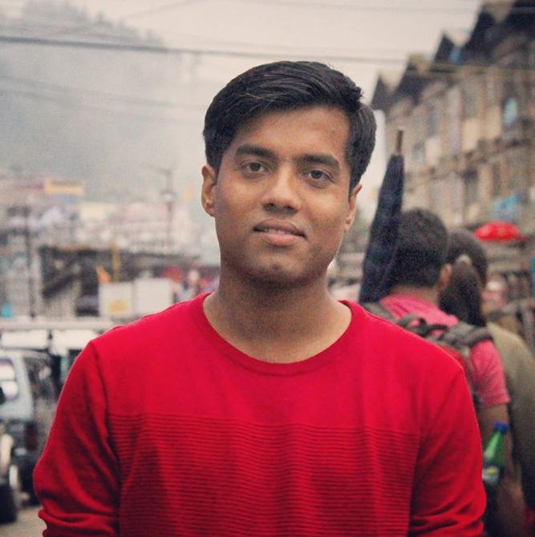
Team
Gurtej Singh Rehal
Subhadeep Datta
Ashish Kumar Sharma
Qualification: B.Tech in Information Technology (2020)
Qualification: B.Tech in Mechanical Engineering (2018)
Qualification: B.Tech in Information Technology (2020)
Skills: Front-End development, Tensorflow, Machine Learning
Skills: Automation, Python, IoT
Skills: Database Management, Python
Gurtej Singh Rehal
Subhadeep Datta
Ashish Kumar Sharma
Achievements: Promising Student Innovator Award (AICTE & CII), Top 8 in SIH-2017
Achievements: Finalist of Smart India Hackathon - 2018
Achievements: Finalist of Smart India Hackathon - 2018

Slide 15
Thank You

